Slide 1
Cognitive Science for AI
Psychology: Memory

Slide 2
Cognitive Psychology
Memory
Learning
Vision
Language
Reasoning

Slide 3

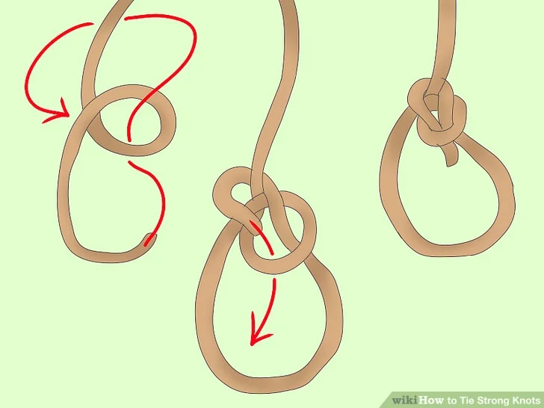
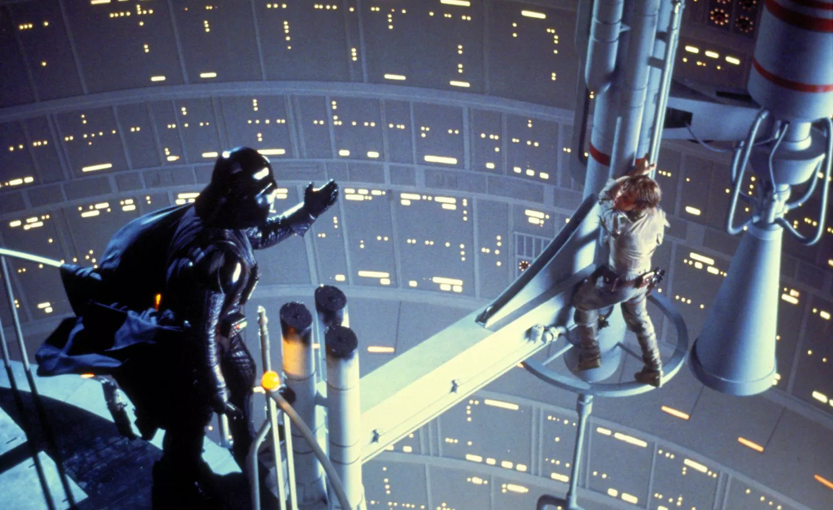
Memory
Semantic - facts, word meanings
Perceptual - faces, voices, places
Procedural - motor skills, directions
Episodic - time/place events
PHOTO: LUCASFILM

Slide 4
Memorizing Sequences
7 0 3 2 1 2 8 5 7

Slide 5
Memorizing Sequences
Seven plus or minus two - number of objects in short term memory
Repetition
Primacy
Recency
Context

Slide 6
Memorizing Sequences
7 0 3 2 1 2 8 5 7
Seven plus or minus two - number of objects in short term memory
Repetition - repeat repeat repeat
Primacy - earlier in the list are repeated more often
Recency - later in the list easier to access and ‘overwrite’ earlier ones
Context - nothing is in a vacuum, you learn in a situation
Memorizing sequences of numbers is not a ‘natural’ (ecological) task

Slide 7
Information Processing Model
Sensory Memory (iconic/echoic)
Working Memory (STM - short term memory)
Long Term Memory (LTM)
rehearsal
senses
attention
encoding
Sensory
STM
LTM
retrieval
forgotten
forgotten
forgotten
Atkinson-Shifrin model

Slide 8
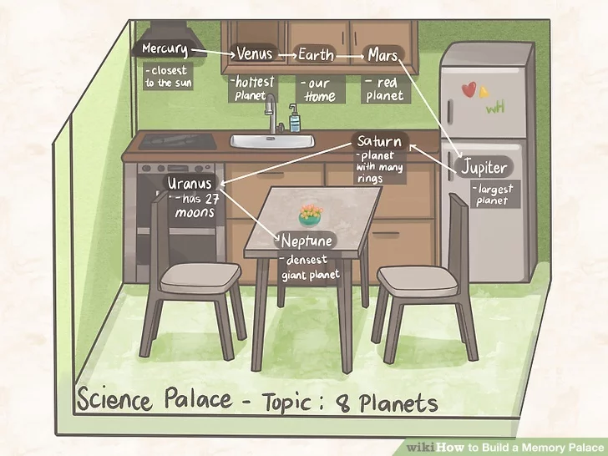
Memory Techniques
Chunking
703 = Northern Virginia
212 = DC
857 = Boston
7 0 3 2 1 2 8 5 7
7 0 3-2 1 2-8 5 7 = NVa DC Boston
Mnemonics
Roy G. Biv:
Red Orange Yellow Green Blue Indigo Violet
The “Memory Palace”
Use a “natural” memory sequence to string along an arbitrary one
https://www.wikihow.com/Build-a-Memory-Palace

Slide 9
Cognitive Science for AI
Psychology: Learning

Slide 10
Learning
Habituation - repetition reduces response strength
Fixed Action Patterns - imprinting
Classical Conditioning - Pavlov’s salivating dog
Operant Conditioning - Skinner, reinforcement schedule, reward and punishment
‘Insight’ Learning

Slide 11
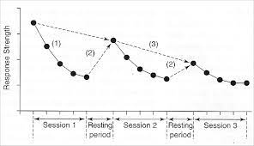
Habituation
Given an existing stimulus and response
Repetition of stimulus reduces response strength
Simplest, most universal form of learning
Works at many levels
Full organism - fear
Specific behaviors -
Senses, individual neurons - trigger fatigue
Biochemical response - in drug addiction

Slide 12
Fixed Action Patterns
Fixed

Slide 13
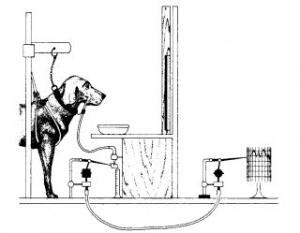
Classical Conditioning
Pavlov’s dog
Food causes dog to salivate
Ring bell every time dog presented with food
Eventually ringing bell causes dog to salivate
Associative Learning
Unconditioned Stimulus US - sight/smell of food
Unconditioned Response UR - salivation
Reflex/built-in biology
Associated US and UR
Conditioned Stimulus CS - bell ringing
arbitrary
https://www.psychologytoday.com/intl/blog/dont-delay/201310/how-not-be-pavlovs-dog

Slide 14
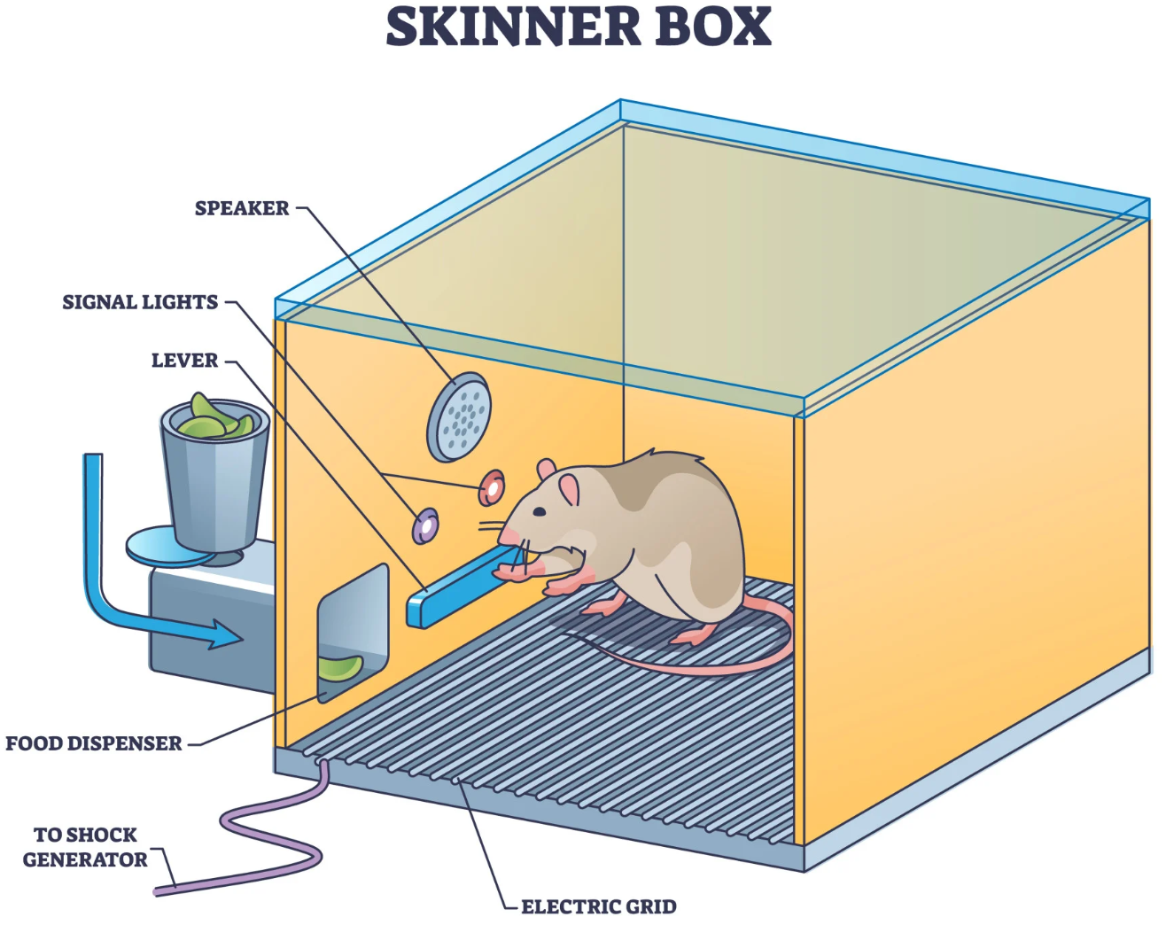
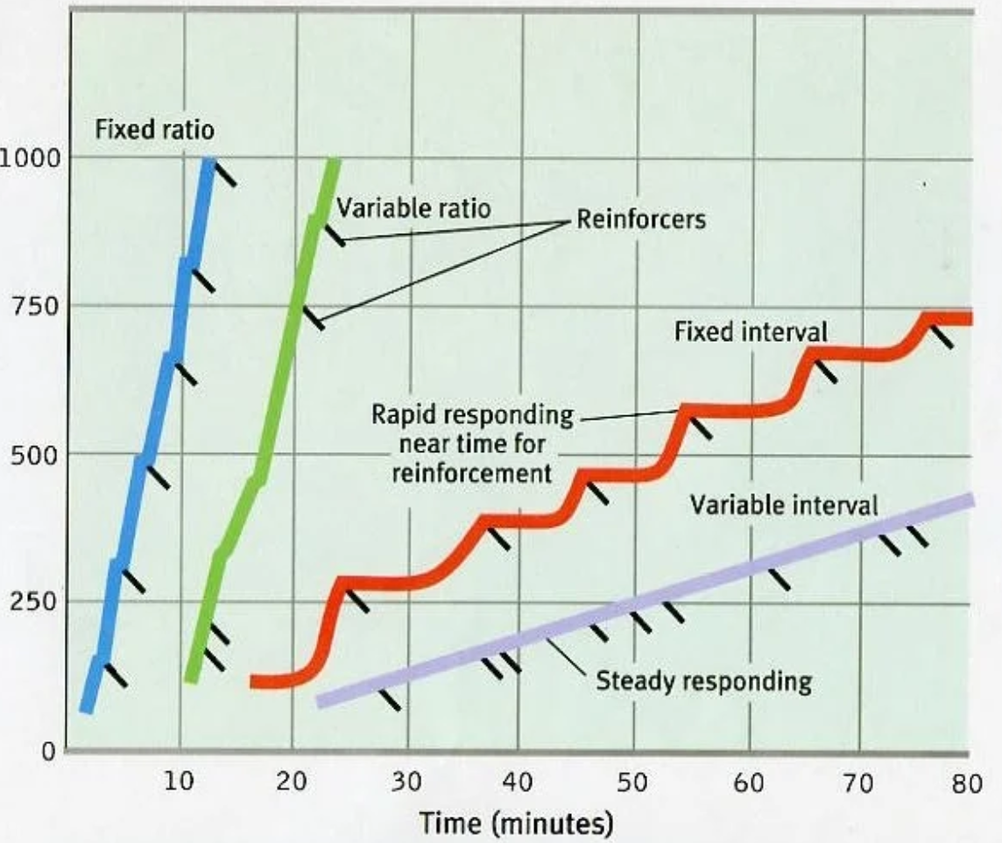
Operant Conditioning
Training
treat for a desired action
shock for an undesired action
Reinforcement: reward and punishment
positive and negative
Schedules
Fixed and variable interval (time)
Fixed and variable ratio (number of instances)
Factors
Extinction - how long til response unlearned
Satiation - enough reinforcement may satisfy motivation
Immediacy - how soon reinforcement occurs after action
Consistency - learning slower with longer spacing
Strength - stronger stimulus makes learning faster
Best Schedule?
variable ratio
mitigates extinction
Worst Schedule?
variable interval
irrelevant connection
In practice: circus animals, slot machines, flashcards
https://www.simplypsychology.org/schedules-of-reinforcement.html

Slide 15
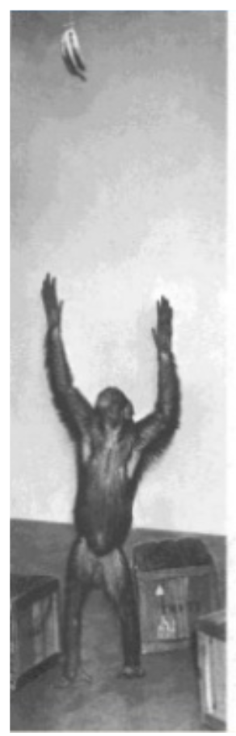
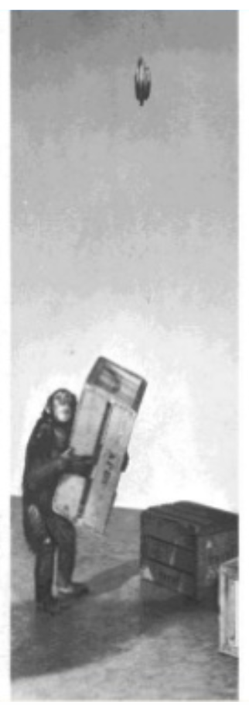
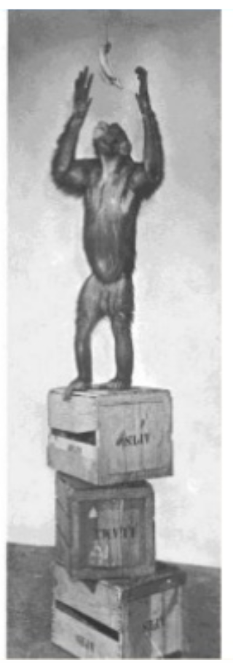
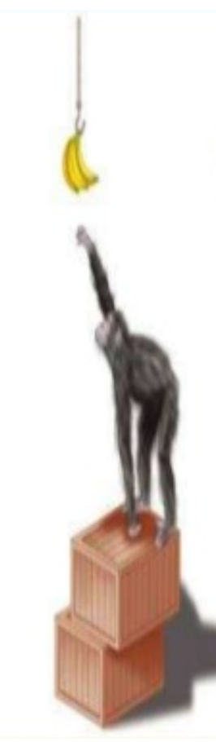
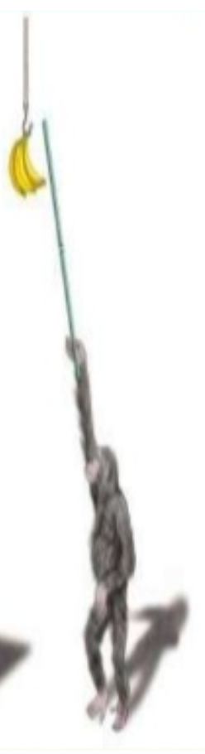
Insight Learning
http://srividyagurugubilly.blogspot.com/2019/10/psychology-of-teaching-and-learning.html

Slide 16
Lessons from Learning/Memory
There’s no one location for memory. It is everywhere in the brain.
Memory degrades over time
Memory is fallible
There’s a lot we just don’t know
Neural mechanism

